Slide 1





The TU Ilmenau Narrative: A Glimpse into International Student Experiences
Group Members
Sitarah Khurram
Muhammad Mustafa Poonjla
Syed Farhaj Asghar Kazmi
Syed Asad Tahseen Rizvi
16 July 2024

Slide 2


PERSONAL NARRATIVES
1
2
3
4
Highs
5
Experiencing diverse cultural events, such as international food festivals and student nights, has enriched our time in Ilmenau,
6
7
8
Lows
9
Struggling with the cold and snowy winters in Ilmenau, which were much harsher than back home.

Slide 3
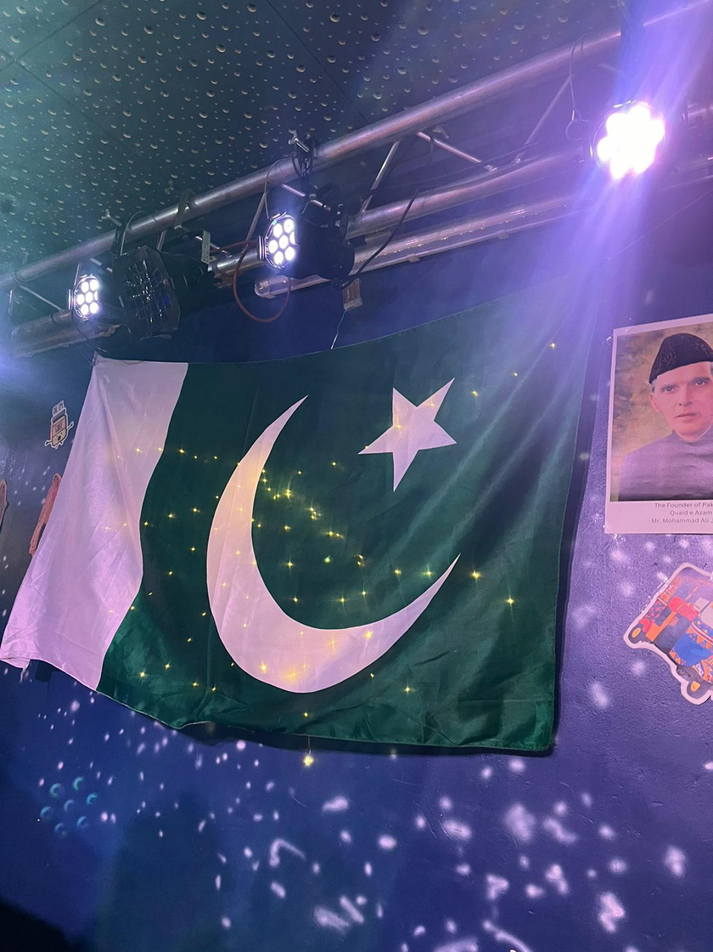
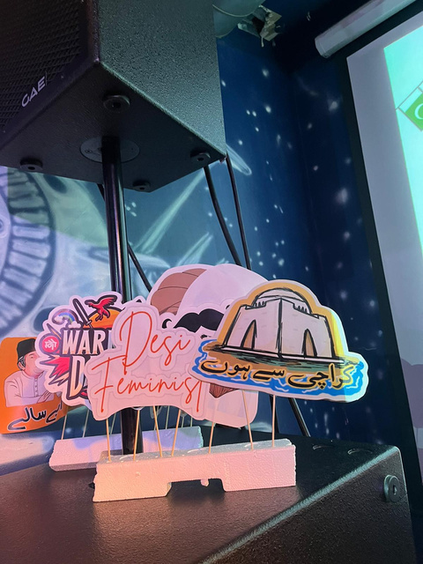
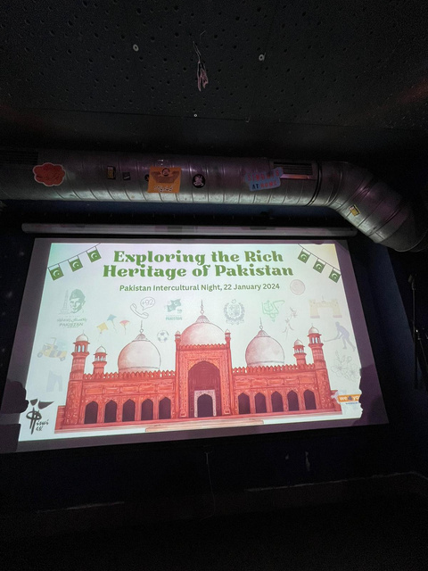
1
Memorable Events
2
3
Pakistan Cultural Day
4
One of the standout moments was celebrating Pakistan Cultural Day, where we had the opportunity to showcase our rich heritage through traditional music, dance, and cuisine.
This event not only allowed us to share our culture but also strengthened our bond with the international student community.
5
6
7
8
9

Slide 4





Challenges Faced by International Students
Navigating life at TU Ilmenau, international students encounter a variety of challenges:
Harsh Weather
Language Barrier
Finding
Jobs

Slide 5




PROBLEM-SOLVING STRATEGIES
1
2
3
Overcoming Language Barriers:
4
Strategy: Enrolled in German language courses and practiced with local students.
Advice: Use language learning apps and seek out language exchange partners to improve fluency.
5
6
7
Finding Jobs and Internships
8
Strategy: Attended university career fairs and networking events to connect with potential employers.
Advice: Tailor your resume to highlight relevant skills and consider learning basic German for better opportunities.
9

Slide 6

CULTURAL INTEGRATION
1
2
3
Academic Culture
4
Shift from a hierarchical to an discussion-oriented approach
Active engagement in seminars and seeking feedback from professors
Initial challenges in adjusting to new academic norms
Collaborating with peers to adapt to academic expectations
5
6
7
Overcoming Language Barriers
8
9
Enrolled in German language courses
Taking part in language sessions

Slide 7

Fostering Cross-Cultural Friendships
1
2
Embracing Cultural Diversity
Improved Language Skills
Stronger Social Network
Greater Adaptability and Flexibility
3
4
5
6
Benefits of Cultural Integration
7
Enhanced personal growth and empathy
Improved intercultural communication skills
Prepared for working in international environments
8
9

Slide 8

COMMUNITY ENGAGEMENT:
1
2
3
Community Engagement is a crucial part of integrating in any community. As a student it provides numurous benefits:
Personal Growth & Development
Academic Enhancement
Professional Development
Enhanced University Experience
4
5
6
7
8
9

Slide 9

1
COMMUNITY ENGAGEMENT:
2
3
4
5
Pakistan Cultural Day
This event happened with the collaboration of intercultural society to introduce Pakistani culture and its vibrant community, It brought people from different cultures and enabled them to exchange it with one another. Pakistani cuisine and the music was also introduced to people from other communities.
We4You Event
Ice Skating
Hiking
6
7
8
9
STW Evening
This event was organized for all the students living in the student dorms to introduce each other and to learn about basic living in Ilmenau.
Fun games were played during this event and winners were also rewarded.
It was a great way to connect with people from different cultures and the local community.

Slide 10






Support Systems
StuRa
The Student Council (StuRa) represents students' interests.
It engages with the university, city, state, and federal government.
StuRa communicates with various university committees.
Contact them at stura@tu-ilmenau.de
Studierendenwerk Thüringen
Provide living places for all the students at TU Ilmenau.
Very affordable.
Assist in moving in.
Help out with any issue regarding housing.
Also, provide house tutors to answer or help in any queries.
We4You
International student service of TU Ilmenau.
Supports students in their everyday study life.
Make students feel comfortable in Ilmenau.
Tips for your start in Ilmenau.
Organize events and excursions.
Provide students with tutors and buddies.
International Office
The international office at TU Ilmenau also provides support for international students.
To support them in their study-related matter.

Slide 11
REFLECTIONS ON GROWTH
1
2
Personal Growth
Academic Challenges and Achievements
Adapting to a rigorous academic environment
Overcoming initial difficulties with advanced coursework and research
Celebrating milestones like passing difficult exams or completing significant projects
3
4
5
2.Independence and Self-reliance
Managing life away from home, including budgeting and daily tasks
Developing time management and organizational skills
Becoming more self-sufficient and resilient
6
7
8
Collective Growth
Teamwork and Collaboration
Working on group projects and research with peers
2. Shared Challenges and Successes
Facing and overcoming common challenges such as homesickness and academic pressure
Strengthening bonds through shared experiences and mutual support
9

Slide 12
Future Outlook
Professional Aspirations
1.Career Goals
Aim to work in cutting-edge research and development in systems and computer engineering
Desire to contribute to innovative projects and technological advancements
Aspiration to secure a position in a leading tech company
1
Impact of Experiences in Ilmenau
Shaping Perspectives
How academic challenges have honed problem-solving and critical thinking skills
The role of intercultural experiences in broadening global outlook
Influence of mentors, peers, and professors on personal and professional development
2. Skills and Competencies Gained
Technical skills acquired through coursework and research projects
Soft skills such as communication, teamwork, and adaptability
Leadership and initiative developed through various student activities and projects
2
3
4
5
6
Personal Aspirations
Cultural Integration and Community Involvement
Continued engagement with the local and international community
Participating in cultural exchange programs and community projects
Building a global network of friends and professional contacts
2. Work-Life Balance
Importance of maintaining a healthy work-life balance
Pursuing hobbies and interests outside of professional life
Emphasis on mental and physical well-being
7
8
9

